Slide 1
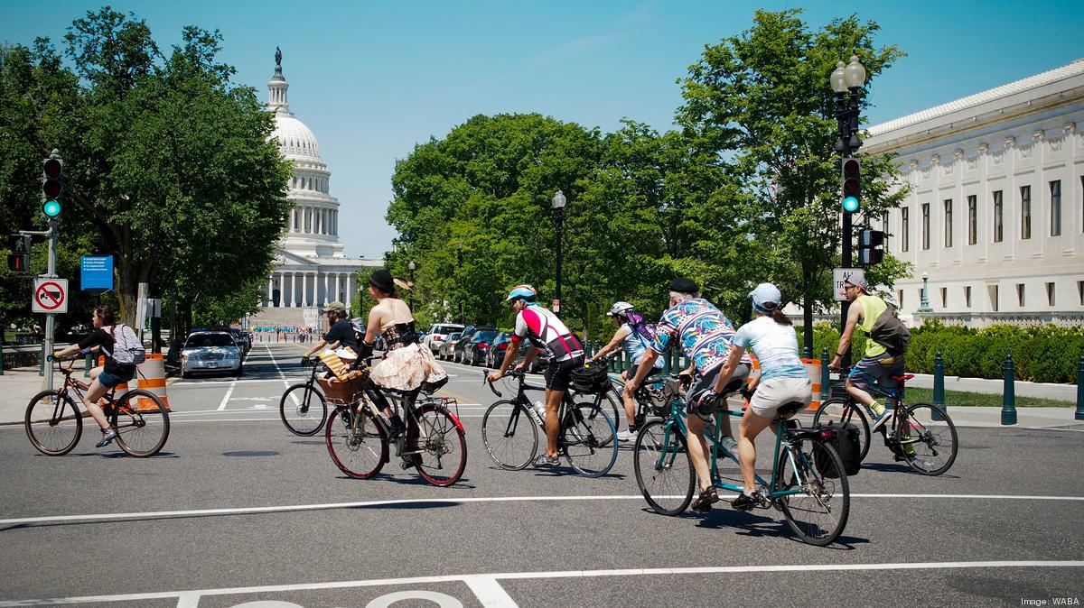
Find Your Safe Biking Routes in Washington D.C.!
By Interacting and Exploring Bike Crash Risk Scores In Different Areas
Teresa Chang, Troy Yang, Ke Zhou,

Slide 2
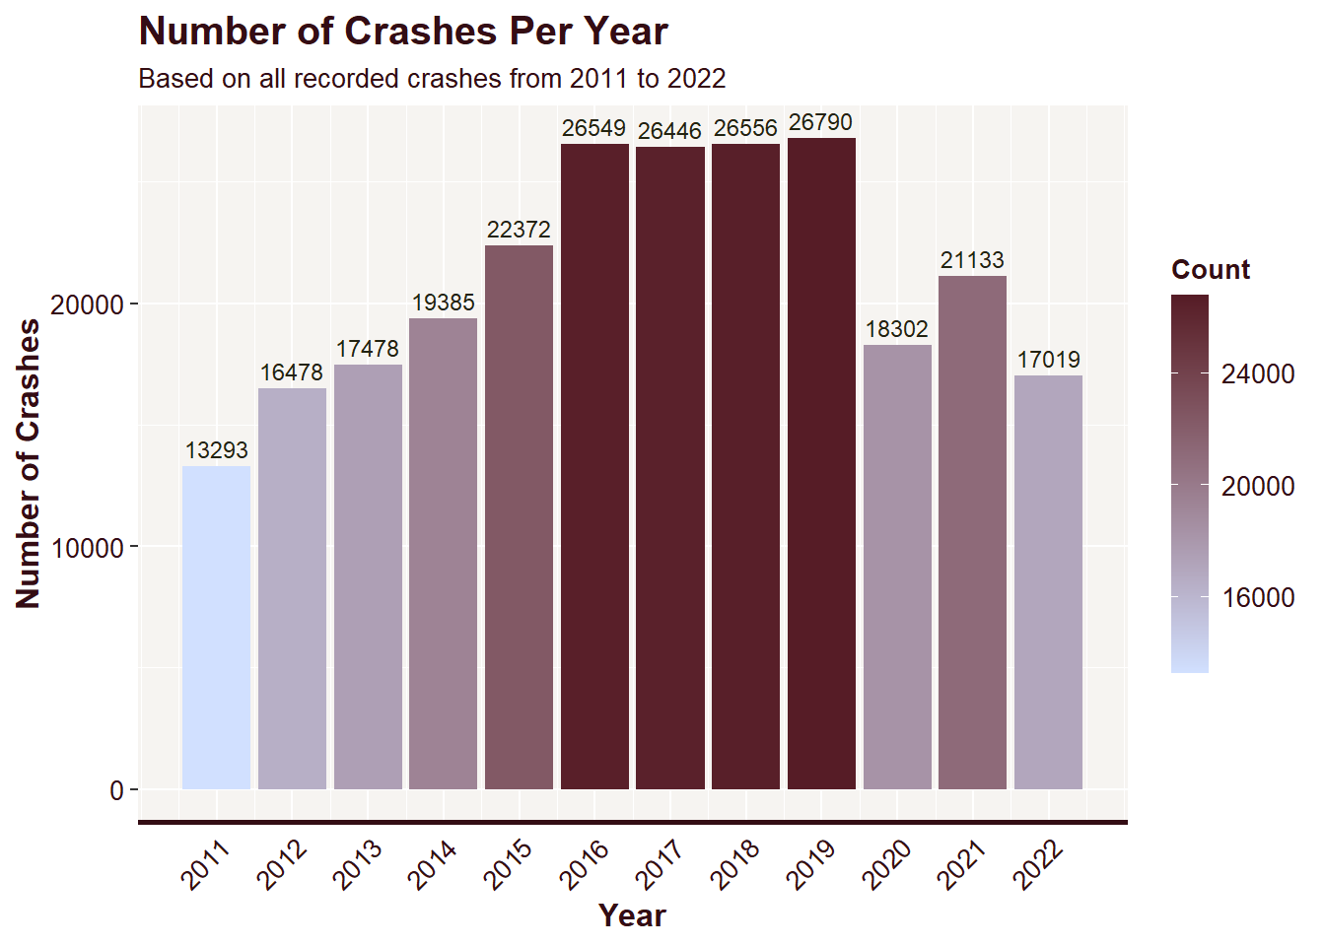

Background
Bicycle transportation safety is a prominent issue in the US, particularly in Washington, D.C., as mixed traffic between bike lanes and motor vehicles can easily lead to crashes and casualties. Washington D.C. has a relatively high bicycle accident rate, ranking among the highest in the nation. Specifically, in 2019, over 800 bicycle accidents occurred in the city, resulting in 14 fatalities and more than 800 injuries.
Notes:
it’s really important to address the biking safety issues in dc and improve the safety of bikders.

Slide 3


A platform that...
can help bikers identify safer routes in Washington and create their personalized biking paths. It also serves as a tool for policymakers to identify high-risk areas and implement effective solutions.
Notes:
Our platform provides bikers service to identify safer biking areas in Washington and enable policy makers to identify high-risk biking areas and provide effective solutions. Users can interact with our map on the website to explore the biking risk scores and other basic information about their potential biking areas, and design their own biking routes accordingly.

Slide 4
Data
Extract
Load into GC
Transform information for web
Transform for Prediction
Model Prediction
Transform prediction for web
Web Map
Notes:
As for our data pipeline, we extracted datasets from the internet and loaded them into Google Cloud Storage and clean them . Then we set up a R virtual machine on google cloud and load the datasets from the storage bucket to transform and build our model. Then we load the model results back to cloud storage, using the model results and the previously extracted datasets we build our web application with JavaScript.

Slide 5
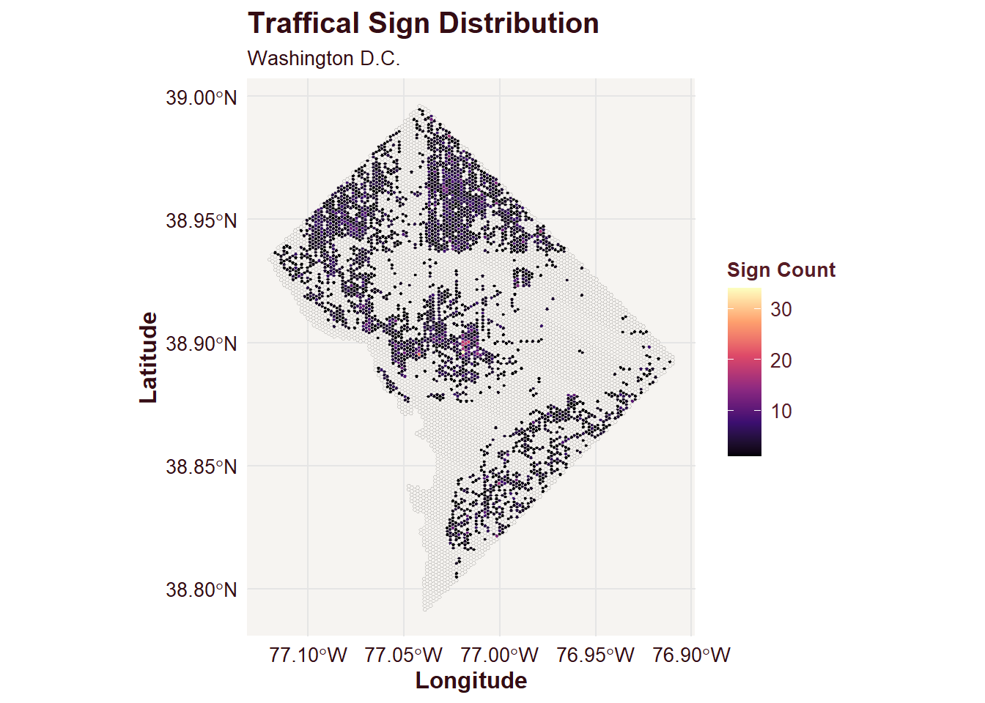
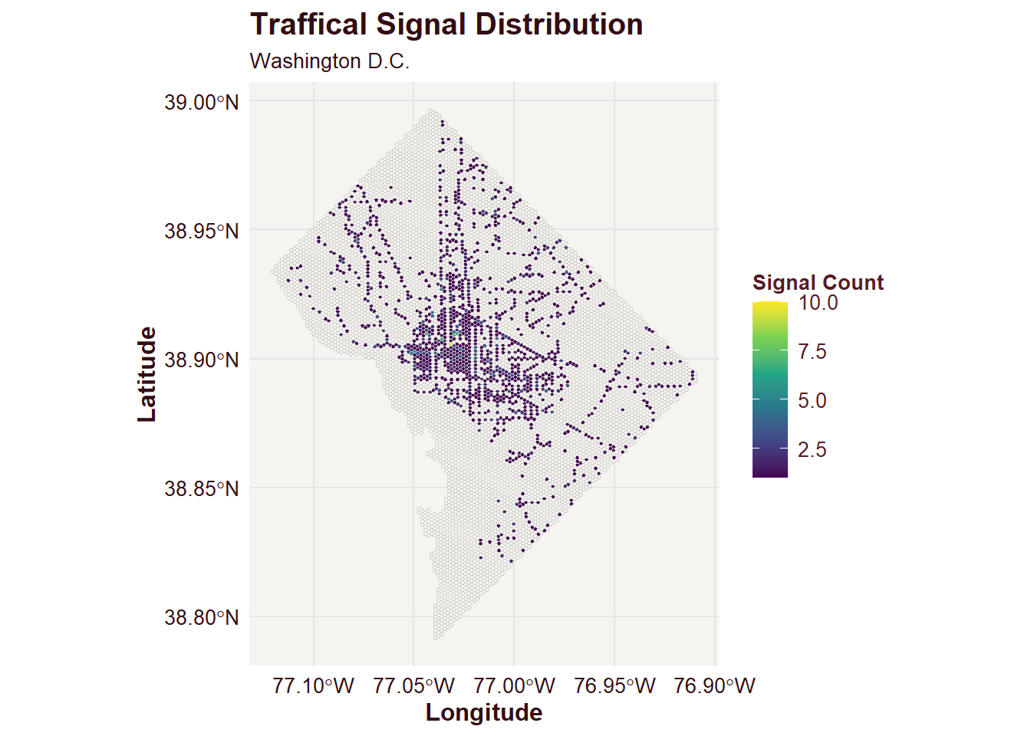

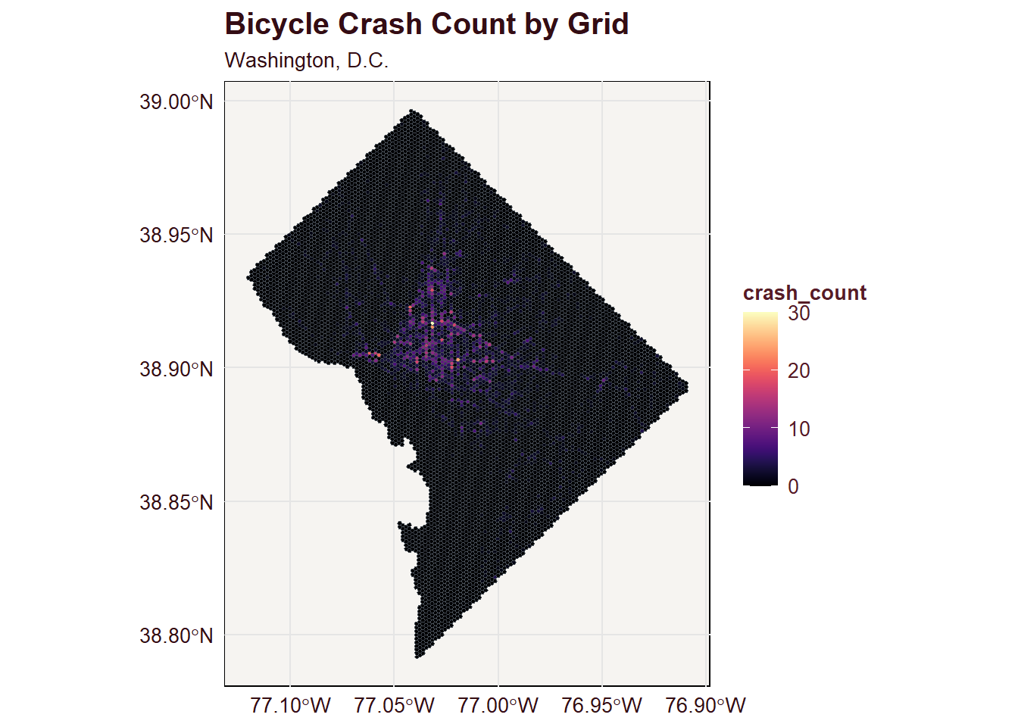
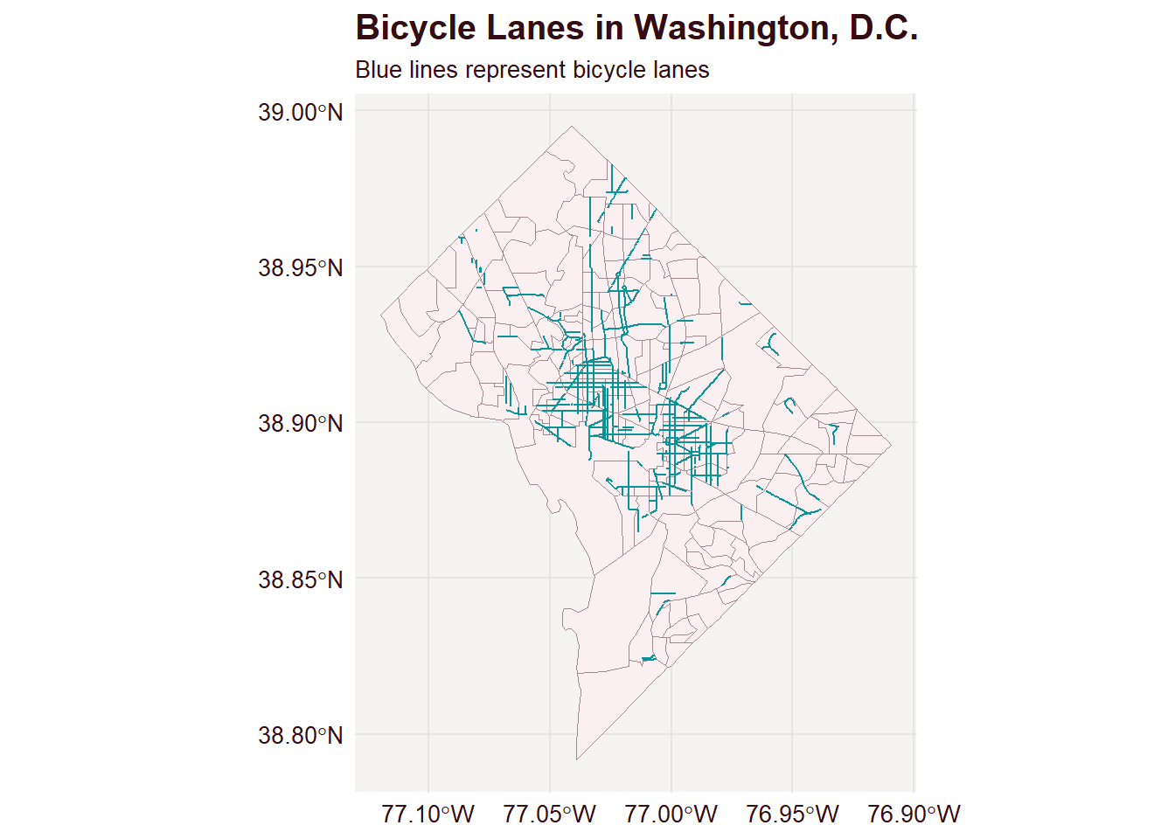
Extract and Load Data into Google Cloud
Notes:
For building our model of predicting bike crash counts and biking risk scores across Washington, we extracted crash data, bike lanes data, traffic signal data, traffic sign data, census data and street information data, which updates daily..

Slide 6
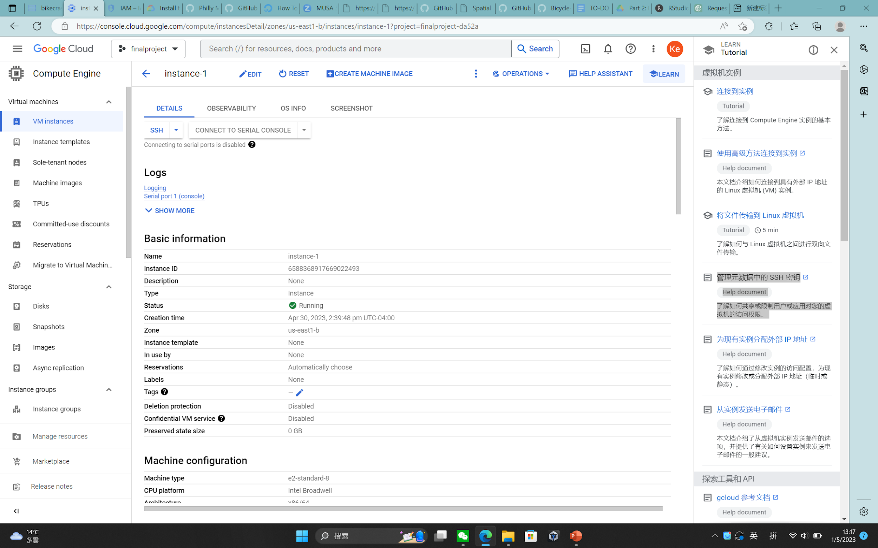
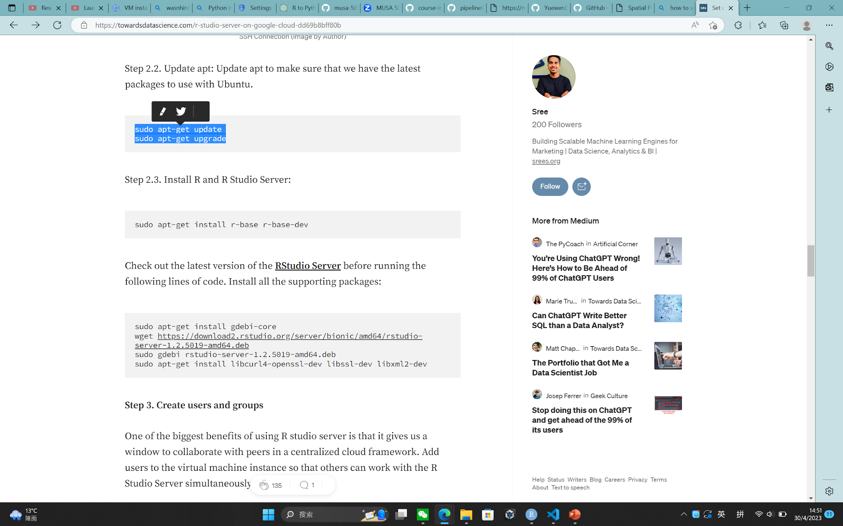
Set up Virtual Machine for Modeling
Notes:
Then we set up our R virtual machine on Google Cloud by configuring a virtual machine instance(Ubuntu OS) and installing R studio and related packages.

Slide 7
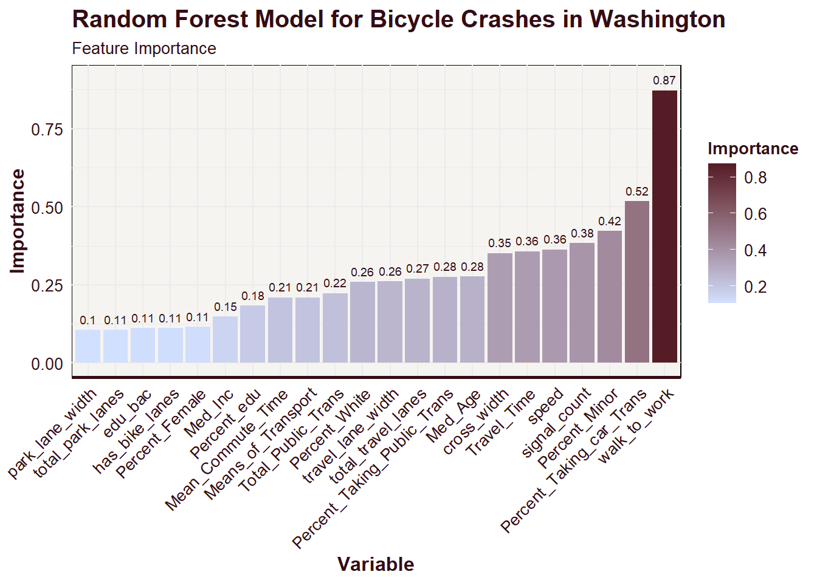
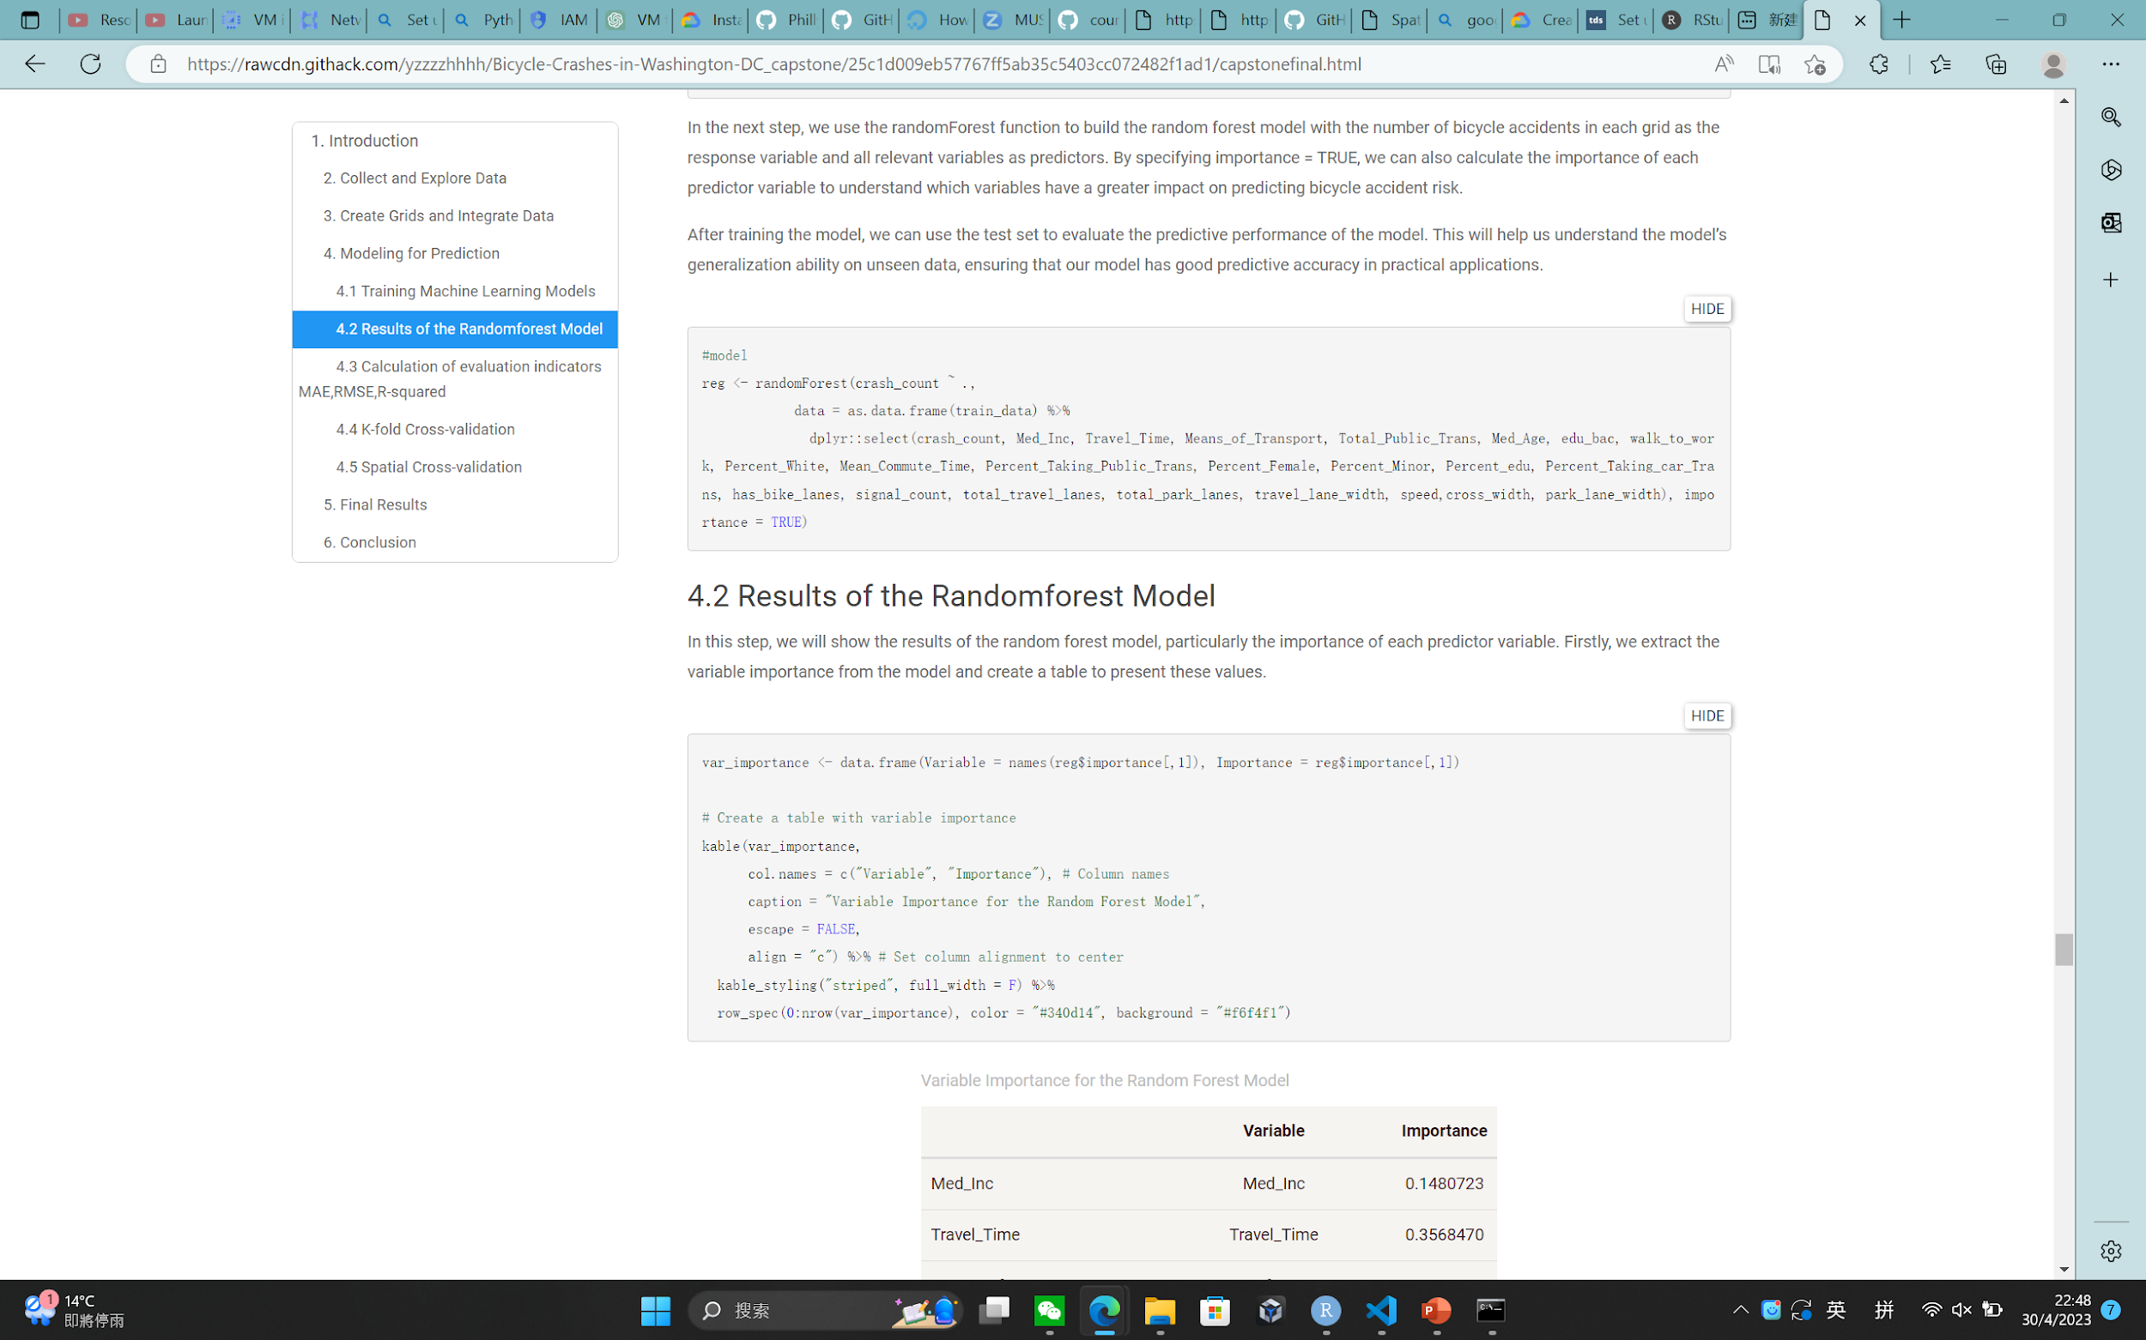

Our Model... Random Forest
Notes:
After selecting variables and experimenting, our final model is a Random Forest Model with 22 independent variables. This plot shows the feature importance of each chosen variable in our model.

Slide 8
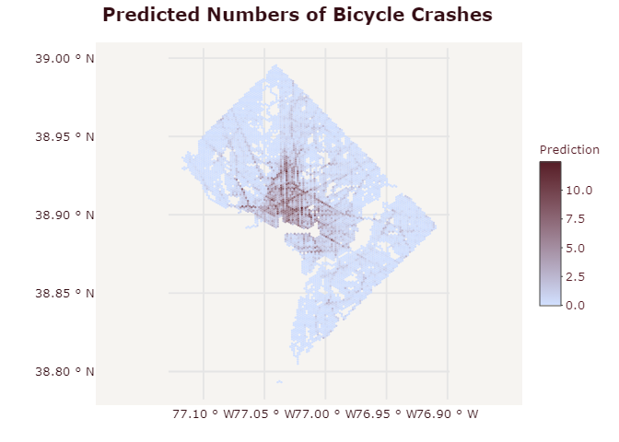
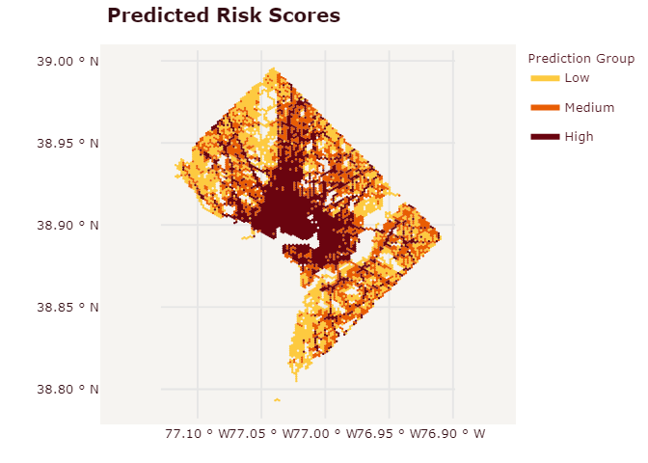
Our Model... Random Forest
Notes:
These are the bicycle crash map and predicted risk score map produced.

Slide 9

Web Application
Users can interact with our map to explore the biking risk scores and other basic information to design their own bike routes and have fun doing so.
Find Your Safe Biking Routes in Washington D.C.!

